Slide 1
Sequential Circuit Design

Slide 2
State Optimization
Equivalent States:
Two states are equivalent if, for each member of the set of inputs,
they give exactly the same output and
send the circuit either to the same state or to an equivalent state.
If two states are equivalent, one can be eliminated without effecting the behavior of the FSM.

Slide 3
State Optimization Algorithm: Row Matching
Two states are equivalent if for all input values, any of the conditions are true:
If two states have the same output AND both transition are to the same next state,
If two states have the same output AND both transition are to each other
If two states have the same output AND both self-loop.
Combine the equivalent states into a new renamed state.
Repeat until no more states are combined.

Slide 4
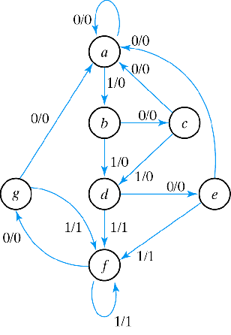
Row Matching Example
State Transition Table
NS output
PS x=0 x=1 x=0 x=1
a a b 0 0
b c d 0 0
c a d 0 0
d e f 0 1
e a f 0 1
f g f 0 1
g a f 0 1

Slide 5
Row Matching Example
State Transition Table
NS output
PS x=0 x=1 x=0 x=1
a a b 0 0
b c d 0 0
c a d 0 0
d e f 0 1
e a f 0 1
f g f 0 1
g a f 0 1

Slide 6
Row Matching Example (cont)
NS output
PS x=0 x=1 x=0 x=1
a a b 0 0
b c d 0 0
c a d 0 0
d e f 0 1
e a f 0 1
f e f 0 1

Slide 7
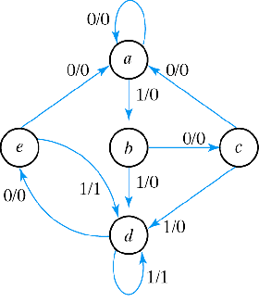
Row Matching Example (cont)
NS output
PS x=0 x=1 x=0 x=1
a a b 0 0
b c d 0 0
c a d 0 0
d e f 0 1
e a f 0 1
f e f 0 1
Reduced State Transition Diagram
NS output
PS x=0 x=1 x=0 x=1
a a b 0 0
b c d 0 0
c a d 0 0
d e d 0 1
e a d 0 1

Slide 8
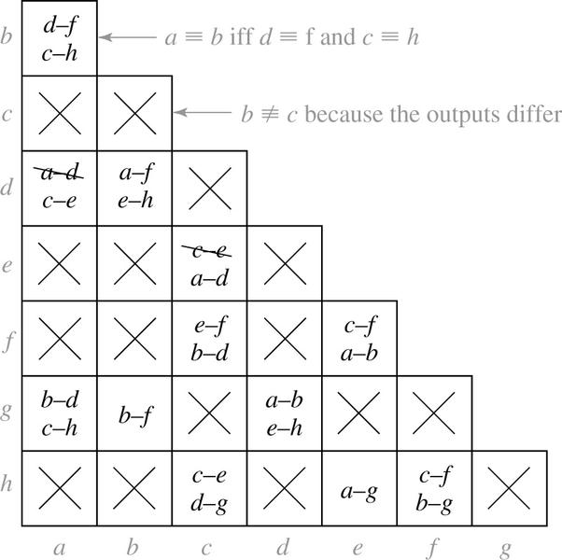
State Optimization Algorithm
Implication Chart
Present State | Next State |  | Present Output
 | X=0 | 1 | X=0
a | d | c | 0
b | f | h | 0
c | e | d | 1
d | a | e | 0
e | c | a | 1
f | f | b | 1
g | b | h | 0
h | c | g | 1

Slide 9
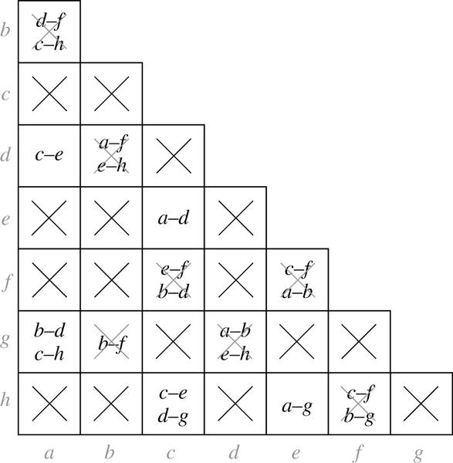
State Optimization Algorithm
Implication Chart After First Pass
Processing order is important

Slide 10
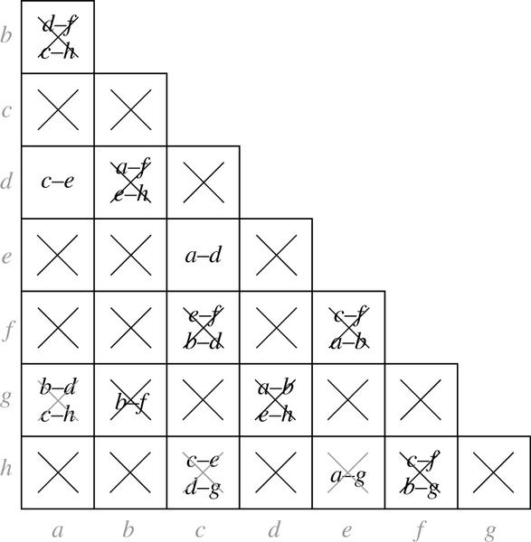
State Optimization Algorithm
Implication Chart After Second Pass
Present State | Next State |  | Output
 | X=0 | 1
a | a | c | 0
b | f | h | 0
c | c | a | 1
f | f | b | 1
g | b | h | 0
h | c | g | 1

Slide 11
Equivalent Sequential Circuits
Definition:
Sequential circuit N1 is equivalent to sequential circuit N2 if
for each state p in N1, there is a state q in N2 such that p ≡ q , and
conversely, for each state s in N2 , there is a state t in N1 such that s ≡ t.

Slide 12
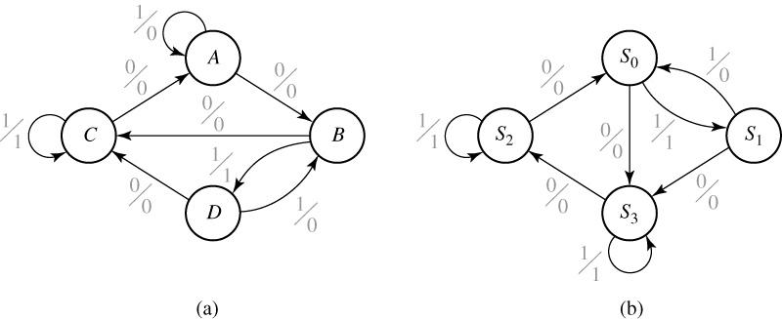
Example
 | X=0 | X=1 | X=0 | X=1
A | B | A | 0 | 0
B | C | D | 0 | 1
C | A | C | 0 | 1
D | C | B | 0 | 0
 | X=0 | X=1 | X=0 | X=1
S₀ | S₃ | S₁ | 0 | 1
S₁ | S₃ | S₀ | 0 | 0
S₂ | S₀ | S₂ | 0 | 0
S₃ | S₂ | S₃ | 0 | 1

Slide 13
 | X=0 | X=1 | X=0 | X=1
A | B | A | 0 | 0
B | C | D | 0 | 1
C | A | C | 0 | 1
D | C | B | 0 | 0
 | X=0 | X=1 | X=0 | X=1
S₀ | S₃ | S₁ | 0 | 1
S₁ | S₃ | S₀ | 0 | 0
S₂ | S₀ | S₂ | 0 | 0
S₃ | S₂ | S₃ | 0 | 1
Implication Tables:
S₀
S₁
S₂
S₃
D | C | B | A

Slide 14
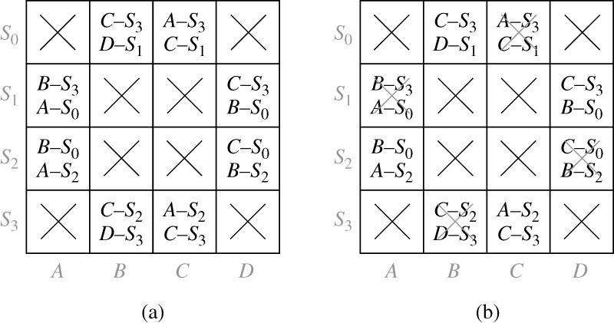
 | X=0 | X=1 | X=0 | X=1
A | B | A | 0 | 0
B | C | D | 0 | 1
C | A | C | 0 | 1
D | C | B | 0 | 0
 | X=0 | X=1 | X=0 | X=1
S₀ | S₃ | S₁ | 0 | 1
S₁ | S₃ | S₀ | 0 | 0
S₂ | S₀ | S₂ | 0 | 0
S₃ | S₂ | S₃ | 0 | 1
Implication Tables:

Slide 15
 | X=0 | X=1 | X=0 | X=1
A | B | A | 0 | 0
B | C | D | 0 | 1
C | A | C | 0 | 1
D | C | B | 0 | 0
 | X=0 | X=1 | X=0 | X=1
S₀ | S₃ | S₁ | 0 | 1
S₁ | S₃ | S₀ | 0 | 0
S₂ | S₀ | S₂ | 0 | 0
S₃ | S₂ | S₃ | 0 | 1
Implication Tables:

Slide 16
State Encoding
The simplest assignment of s coded states to 2^{n} possible states is to use the first s binary integers in binary counting order.
000, 001, 010, 011, 100
However, the simplest state assignment does not always lead to the simplest circuit.
In fact, the state assignment often has a major effect on circuit cost (was previously shown).
In general, the only formal way to find the best assignment is to try all the assignments.
That’s too much work!!

Slide 17
Example
Design a clocked synchronous state machine with two inputs, A and B, and a single output Z that is 1 if:
– A had the same value at each of the two previous clock ticks, or
– B has been 1 since the last time that the first condition was true.
– Otherwise, the output should be 0.
A
Z
B

Slide 18
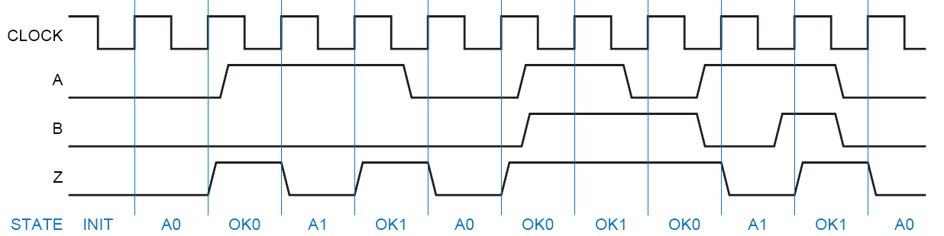
Timing Diagram

Slide 19
Moore Machine
A0: got 0 on A
OKA0: still OK (because from an OK state, got B=1), and got a 0 on A
A1: got 1 on A
Reset/0
OKA1: still OK (because from an OK state, got B=1), and got a 1 on A
OK00: got 00 on A
init
OK11: got 11 on A
10
00
11
01
00
01
10
A1
A0
00
11
10
01
10
11
00
10
00
11
00
01
10
OK11
OK00
01
11
10
00
11
01
11
OKA1
OKA0
01

Slide 20
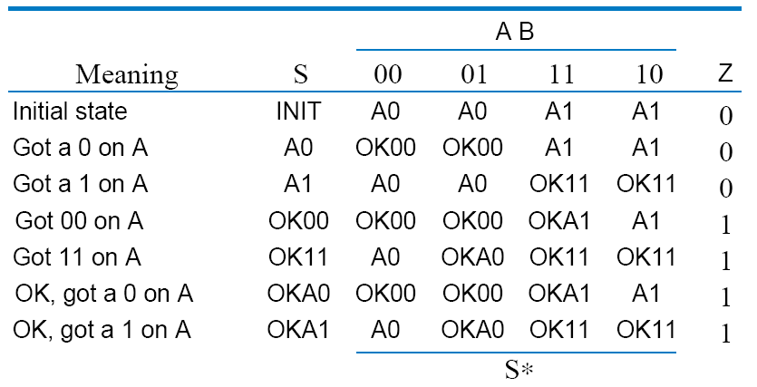
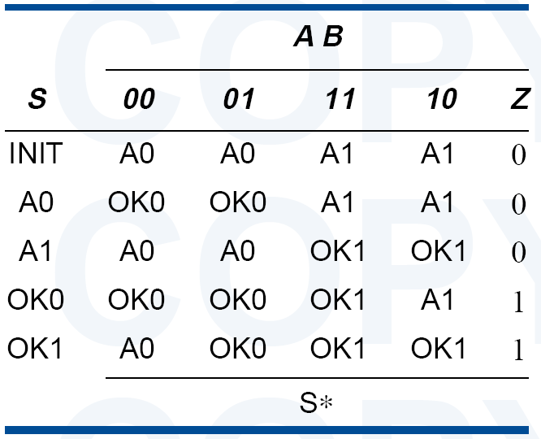
State Table
OK00 and OKA0 are equivalent
OK11 and OKA1 are equivalent

Slide 21
Moore Machine
A0: got 0 on A
OKA0: still OK (because from an OK state, got B=1), and got a 0 on A
A1: got 1 on A
Reset/0
OKA1: still OK (because from an OK state, got B=1), and got a 1 on A
OK00: got 00 on A
init
OK11: got 11 on A
10
00
11
01
00/01
10
A1
A0
00
11
10
01
11
10
00
11
00
01
10
OK1
11
OK0
11
01

Slide 22
State Encoding
Guidelines:
Choose an initial coded state into which the machine can easily be forced at reset
00. . . 00 or 11. . . 11 in typical circuits.
Minimize the number of state variables that change on each transition.
Maximize the number of state variables that don’t change in a group of related states
i.e., a group of states in which most of transitions stay in the group.

Slide 23
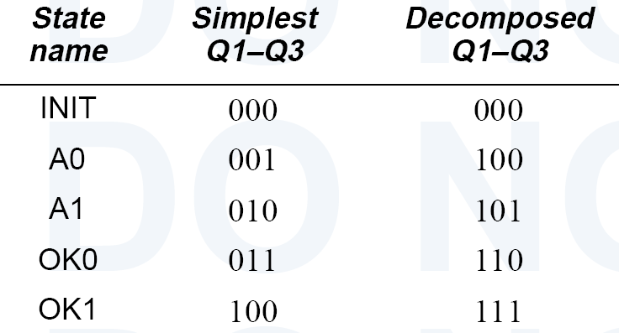

State Encoding
Samples:

Slide 24
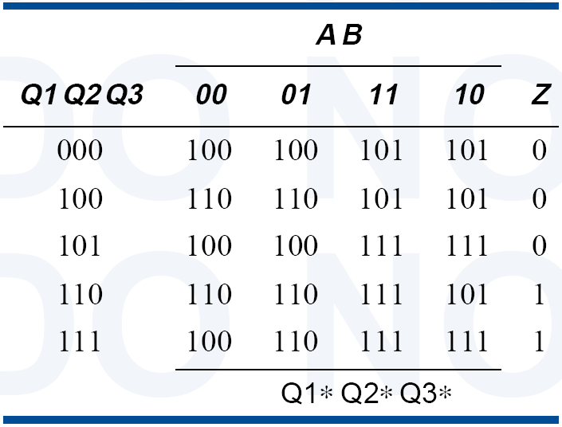
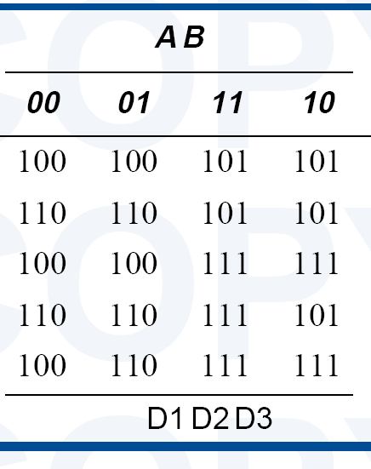
Synthesis Using D FF
Present State
Next State
Output

Slide 25
State Assignment
Unused States:
Each of the m states must be assigned a unique code
Minimum number of bits required is n such that n ≥ log2 m where x is the smallest integer ≥ x
There are 2^{n} - m unused states

Slide 26
State Assignment
Unused States:
Minimal risk:
Assumes: FSM may get into unused (or “illegal”) states,
Due to a hardware failure, an unexpected input
→ Unused states go to the “initial” state (or a legal state)
Minimal cost:
Assumes: FSM never enters an unused state
→ Next-state entries of the unused states can be marked as “don’t-cares”.

Slide 27
Present State
Next State
Reset/0
init
00
10
01
11
00/01
10
A1
A0
00
11
10
01
11
10
00
11
00
01
10
OK1
11
OK0
11
01

Slide 28
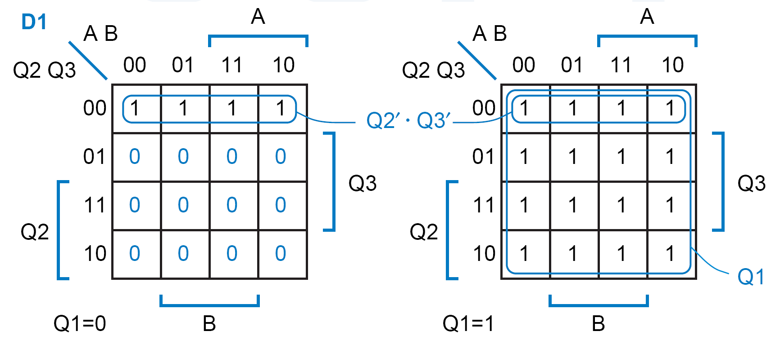
Case 1: Minimal Risk
Assumption:
Unused states go to 000 (minimal risk)
D1 = Q1 + Q2′.Q3′

Slide 29
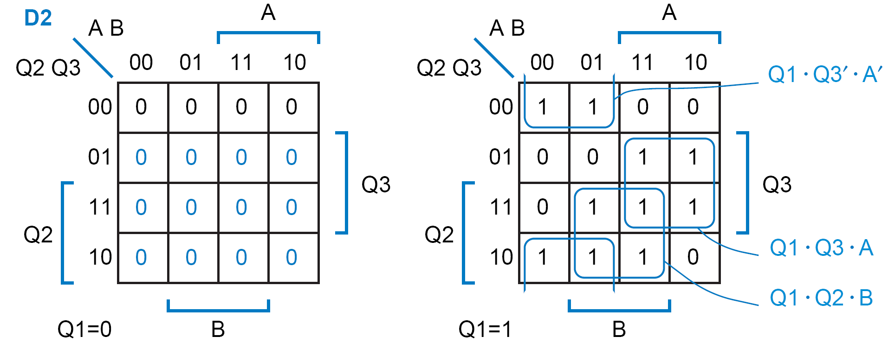
Case 1: D2 Equation
D2 = Q1.Q3′.A′ + Q1.Q3.A + Q1.Q2.B

Slide 30
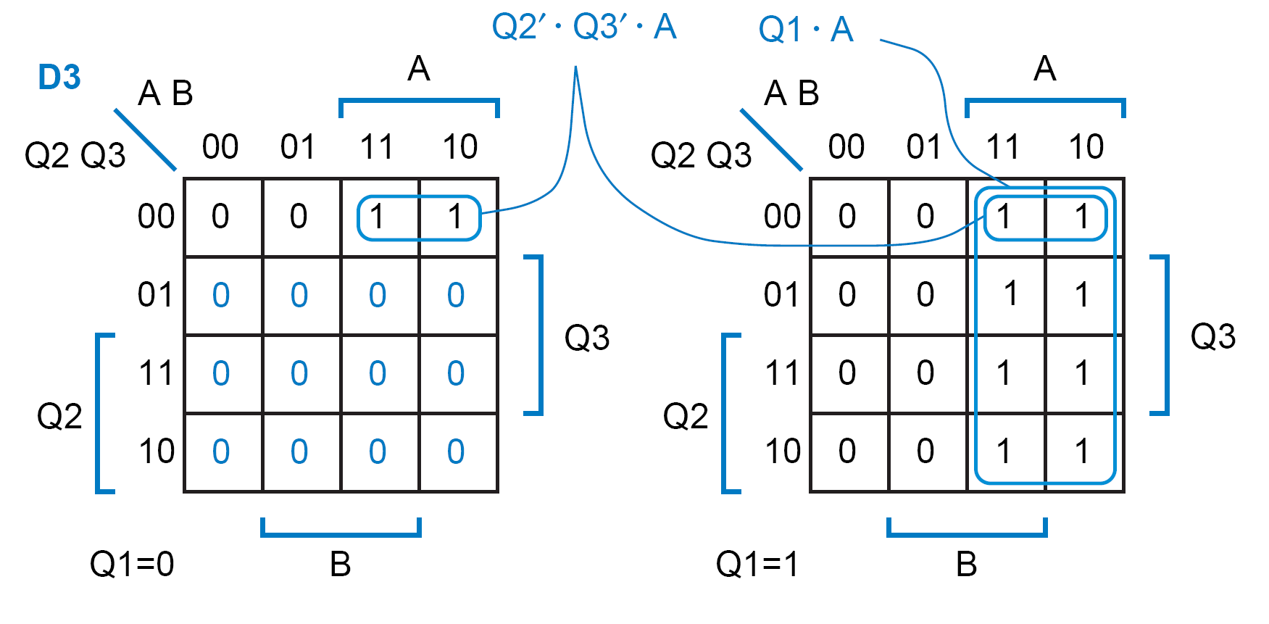
Case 1: D3 Equation
D3 = Q1.A + Q2′.Q3′.A

Slide 31

Case 1: Z Equation
Z = Q1.Q2.Q3′ + Q1.Q2.Q3
= Q1.Q2

Slide 32
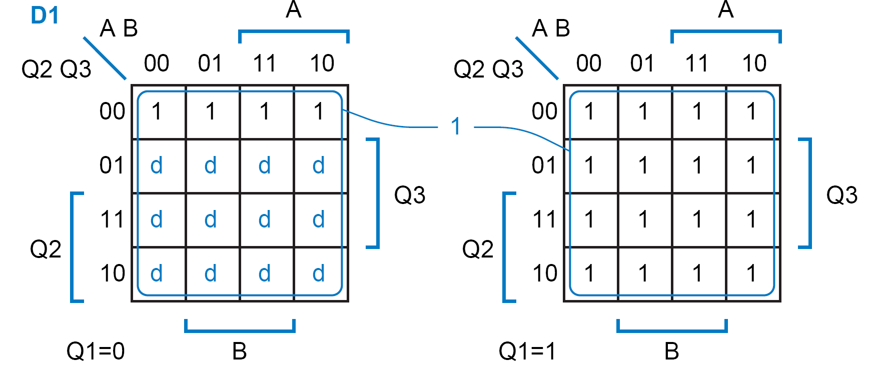
Case 2: Minimal Cost
Assumption:
next states of unused states are “don’t-cares” (minimal cost).
→ Z = don’t care for unused states.
D1 = 1

Slide 33
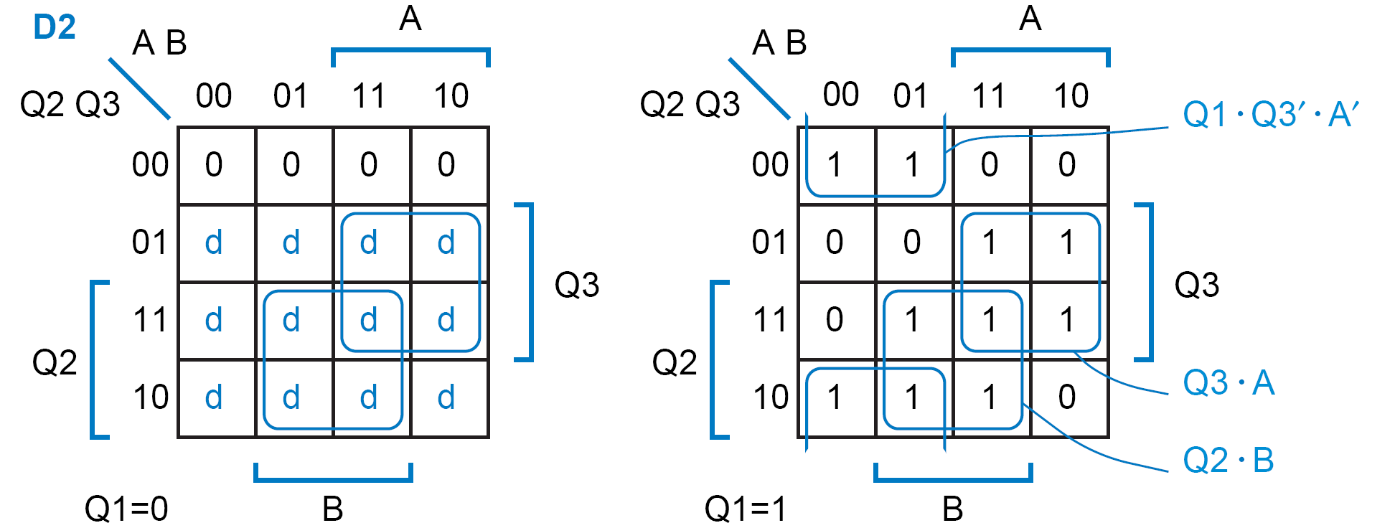
Case 2: D2 Equation
D2 = Q1.Q3′.A′ + Q3.A + Q2.B

Slide 34
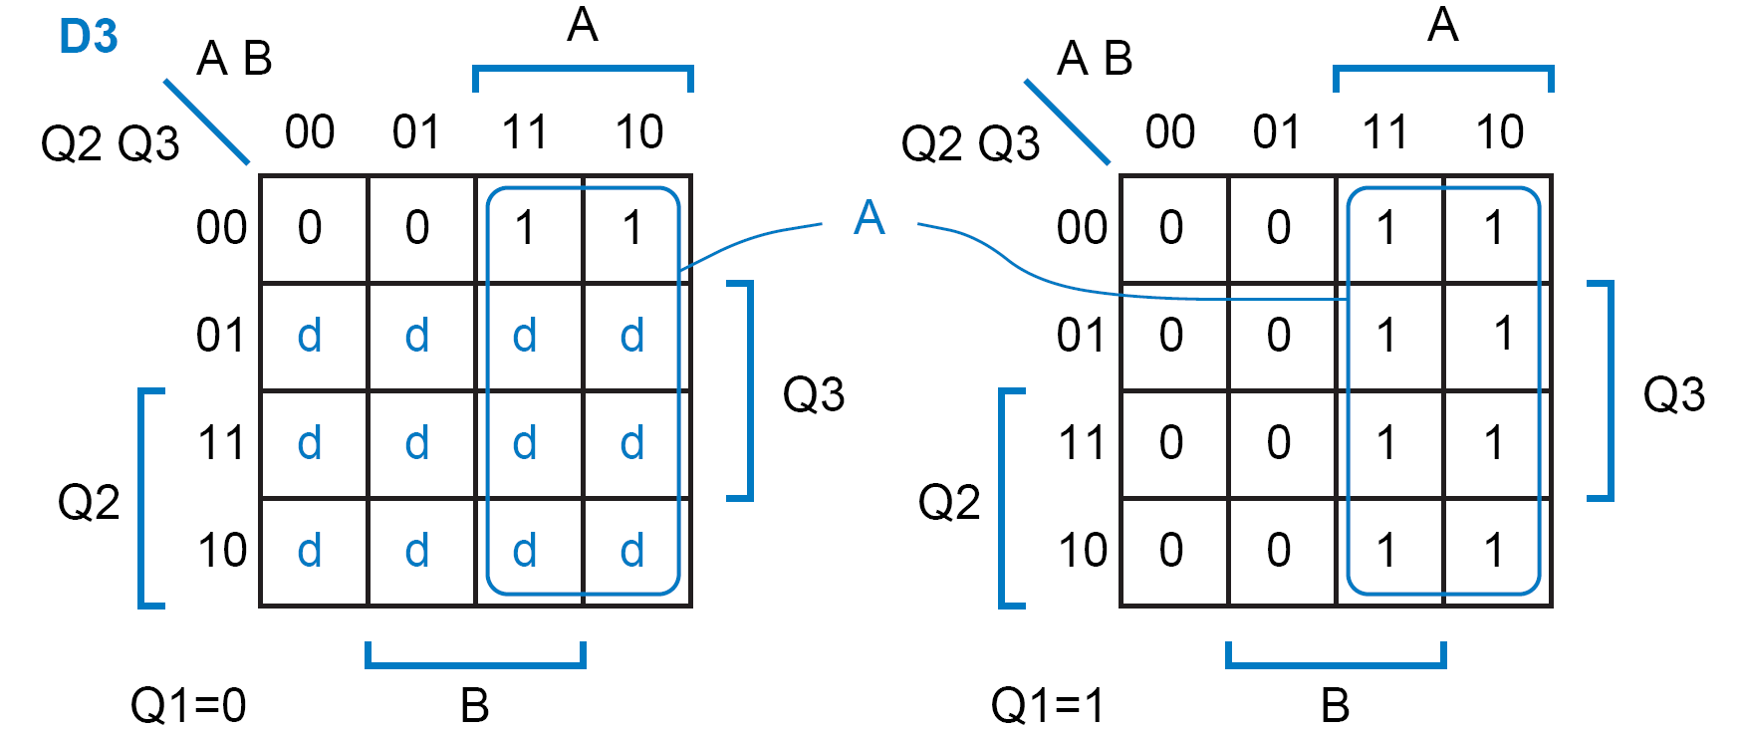
Case 2: D3 Equation
D3 = A

Slide 35
Case 2: Z Equation
Z = Q2

Slide 36
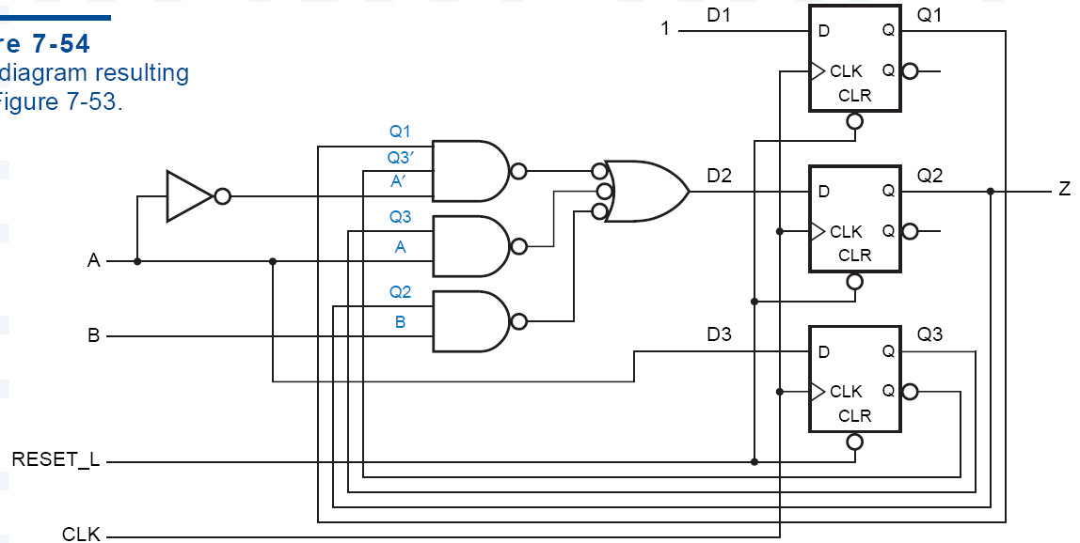
Case 2: Logic Diagram

Slide 37
Third Solution
Trade-off:
Use minimal cost.
Then check to see if there is serious problem.
Incrementally modify.

Slide 38
Case 3: Synthesis Using JK FF
Characteristic Table:
J
K
Q(t+1)
Operation
0
0
Q(t)
No change
0
1
0
Reset
1
0
1
Set
1
1
Q(t)
Complement
Excitation Table:
Q(t)
Q(t+1)
J
K
Operation
0
0
0
X
No change
0
1
1
X
Set
1
0
X
1
Reset
1
1
X
0
No Change

Slide 39
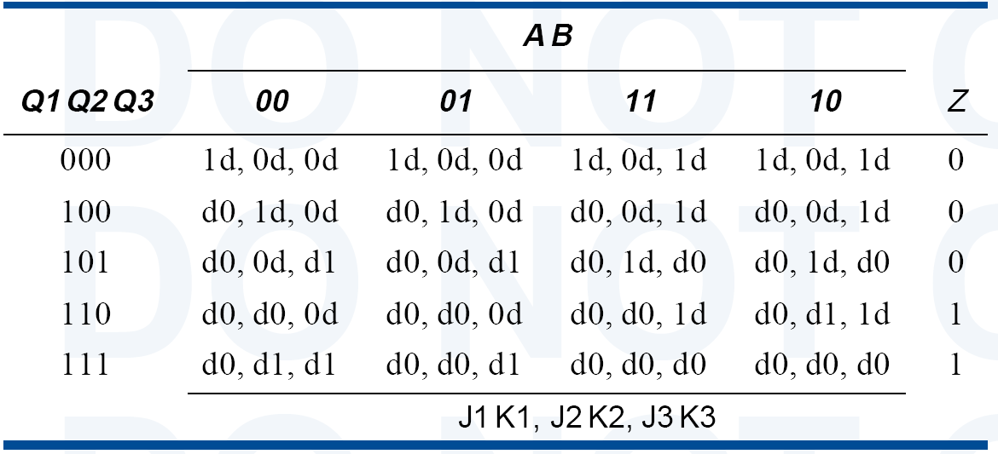

Slide 40
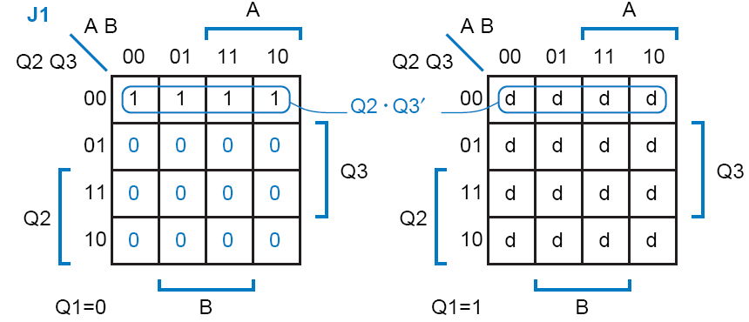
Case 3: Synthesis Using JK FF
Needs separate logic for J and K.
J1 = Q2′.Q3′

Slide 41
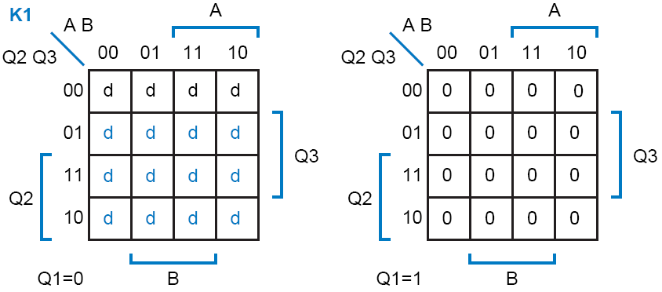
Case 3: Synthesis Using JK FF
K1 = 0

Slide 42
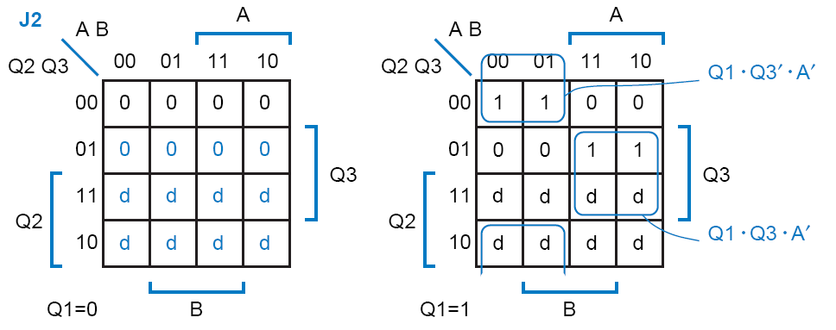
Case 3: Synthesis Using JK FF
J2 = Q1.Q3′.A′ + Q1.Q3.A

Slide 43
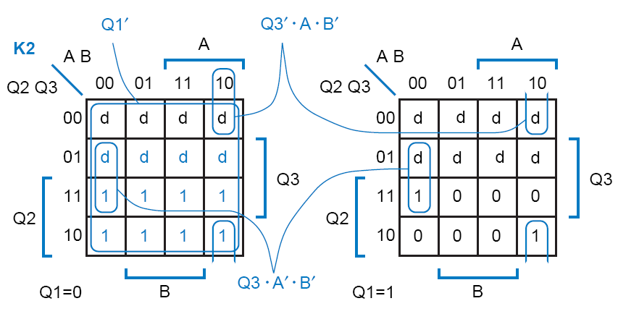
Case 3: Synthesis Using JK FF
K2 = Q1′ + Q3′.A.B′ + Q3.A′.B′

Slide 44
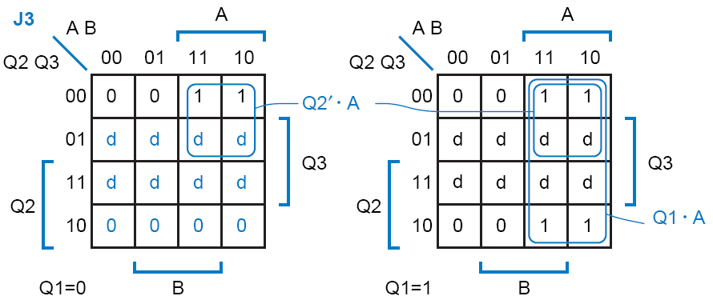
Case 3: Synthesis Using JK FF
J3 = Q2′.A + Q1.A

Slide 45
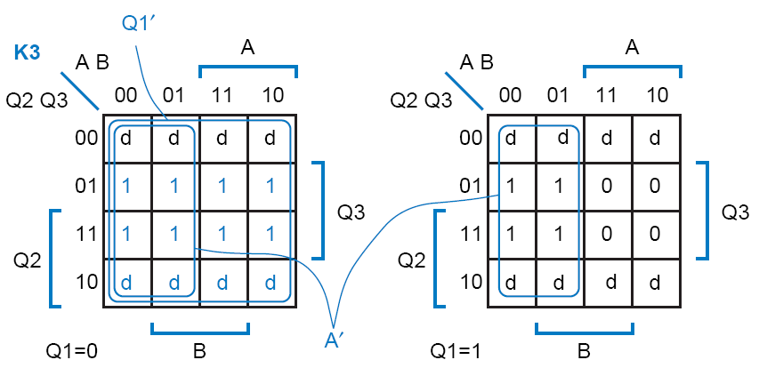
Case 3: Synthesis Using JK FF
K3 = Q1′ + A′

Slide 46
Case 3: Synthesis Using JK FF
These equations take two more gates to realize than minimal-risk equations using D flip-flops
so J-K flip-flops didn’t save us anything

Slide 47
Case 3: Synthesis Using JK FF
Minimal cost using JK FF
J1 =1,
K1 = 0
J2 = Q1.Q3′.A′ + Q3.A
K2 = Q3′.A.B′ + Q3.A′.B′
J3 =A
K3 = A′

Slide 48
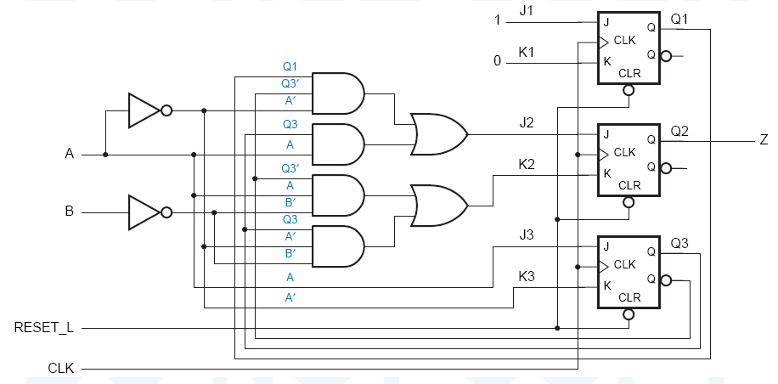
Case 3: Synthesis Using JK FF
This circuit has two more gates than the minimal-cost D circuit
J-K flip-flops still didn’t save us anything.

Slide 49
Sequential Circuit Design Using ROM or PLA
 |  |  |  |  |  | Z
 | Q₁ | Q₂ | Q₃ | X=0 | X=1 | X=0 | X=1
A B C D E H K | 0 0 0 0 1 1 1 | 0 0 1 1 0 0 1 | 0 1 0 1 0 1 0 | 001 011 100 101 101 000 000 | 010 100 100 101 110 000 - | 1 1 0 0 1 0 1 | 0 0 1 1 0 1 -

Slide 50
Sequential Circuit Design Using ROM or PLA
X | Q₁ | Q₂ | Q₃ | Z | D₁ | D₂ | D₃
0 0 0 0 0 0 0 0 1 1 1 1 1 1 1 1 | 0 0 0 0 1 1 1 1 0 0 0 0 1 1 1 1 | 0 0 1 1 0 0 1 1 0 0 1 1 0 0 1 1 | 0 1 0 1 0 1 0 1 0 1 0 1 0 1 0 1 | 1 1 0 0 1 0 1 x 0 0 1 1 0 1 x x | 0 0 1 1 1 0 0 x 0 1 1 1 1 0 x x | 0 1 0 0 0 0 0 x 1 0 0 0 1 0 x x | 1 1 0 1 1 0 0 x 0 0 0 1 0 0 x x
*ROM INPUTS
(X,Q₁,Q₃ and Q₃)
*ROM OUTPUTS (Z,D₁,D₂ and D₃)

Slide 51
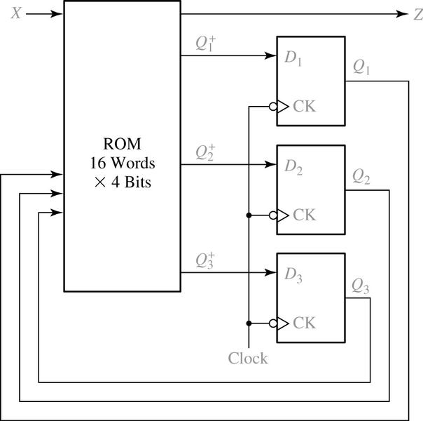
Sequential Circuit Design Using ROM
A ROM with four inputs (2⁴ words) and four outputs is required.

Slide 52
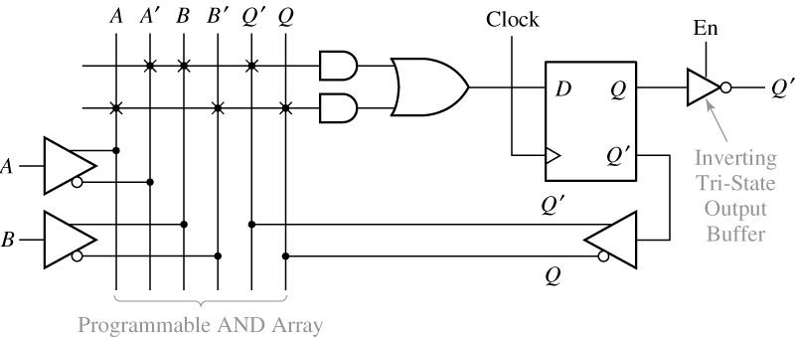
Sequential Circuit Design Using PLA
Segment of Sequential PAL

